Slide 1

The Part-Timer
Notes:
Question
Mission Hello everyone, my name is Joanne Short; I have a passion for communications and I work to help my executive leadership to inform and engage employees, coach and mentor team members and improve the employee experience.
I will share how I part-timed myself into a full-time job doing everything I love and how you may be able to do the same

Slide 2
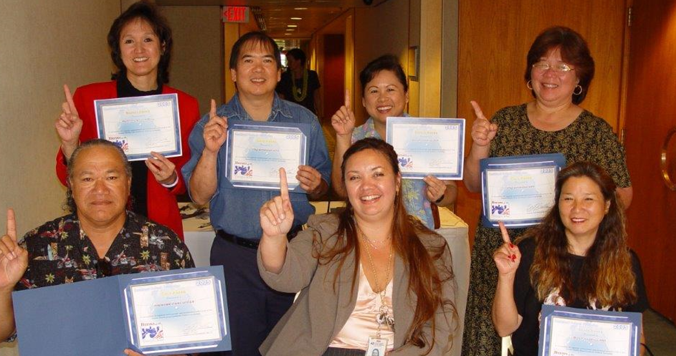
Team Photo
Notes:
Develop skill set/jobs KSA
I soon became the agency project officer for Combined Federal campaign one thing led to another.
First thing was I gained a mentor that taught me everything I needed to know.
Next I learned to integrate what I wanted to do with what I had to do
.

Slide 3
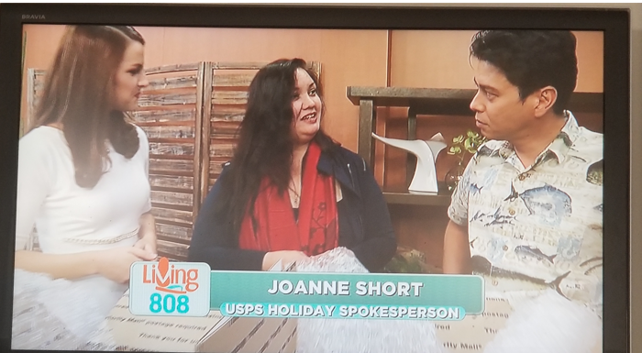
USPS in the News
Notes:
I took the next challenge on live tv promoting products and services for the postal service. I was able to use the skills I had learned over the years to springboard in to my next position. I was able to articulate how my experience and skillset would benefit the leadership team as they faced upcoming challenges COVID-19 would present and how I could support the move to a virtual environment

Slide 4
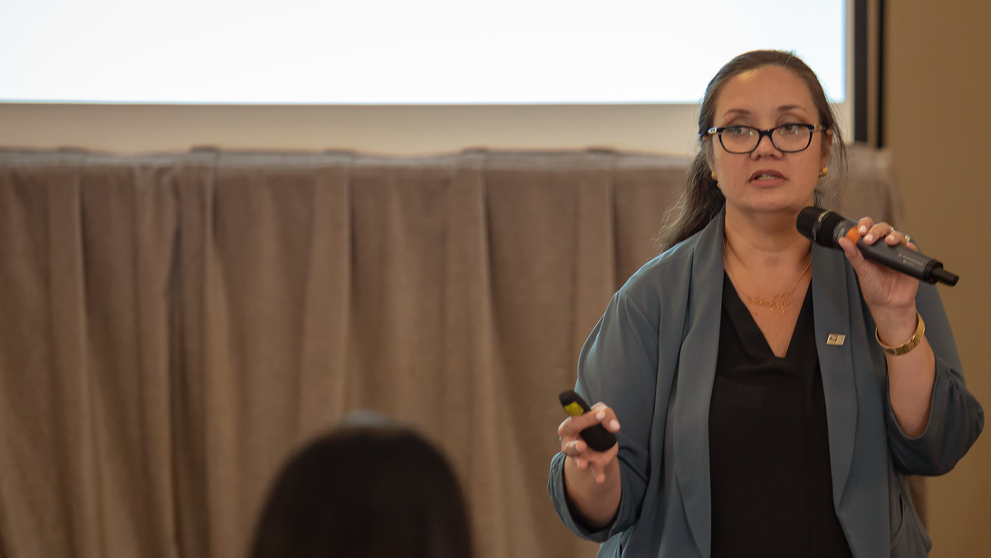
If you work just for money, you’ll never make it, but if you love what you’re doing and you always put the customer first, success will be yours. – Ray Kroc
Notes:
I'm now working on and finishing my Lean Six Sigma Green Belt Certification.
I know this is just the beginning and that there will be other chapters yet to come.
Every day I get so much fulfillment by being seen as a valued member of the team.
I could have accepted every role I was in, and done the minimum, instead I made the choice to expand my role. Without that willingness, there is no way I could have advanced, learned or grown.
Where is your opportunity? Everyday is your opportunity. Every interaction is your interview.
You can build and design a life you love by just raising your hand. My message is simple, never say no to an opportunity. Even if it seems too big, even if its beyond your knowledge, education or skillset.
Just do it.

Slide 5
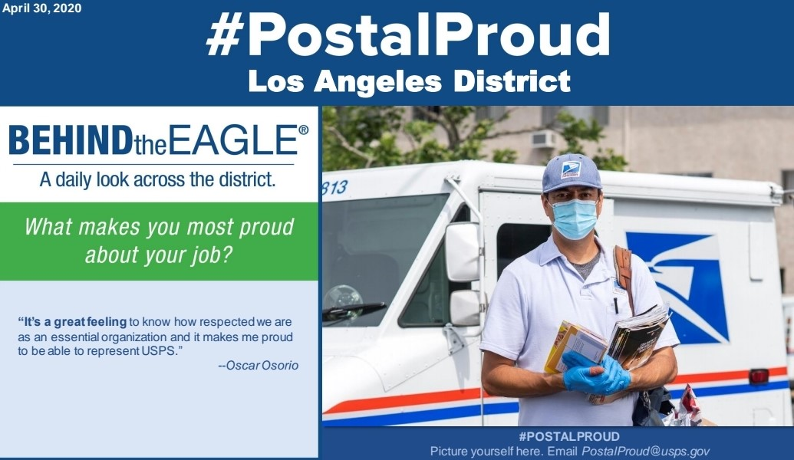
Postal Proud
Notes:
One of my proudest moments was being called by the Manager of communications to fill in as the specialist in one of the largest media markets in the country. They honestly could have called on anyone but they called me because in every other situation, I had made myself available to help at the drop of a hat.
It felt great to be entrusted with such a big responsibility. I even coordinated an appearance of one of our mail carriers on an NBC special to represent the US Postal Service.

